Slide 1
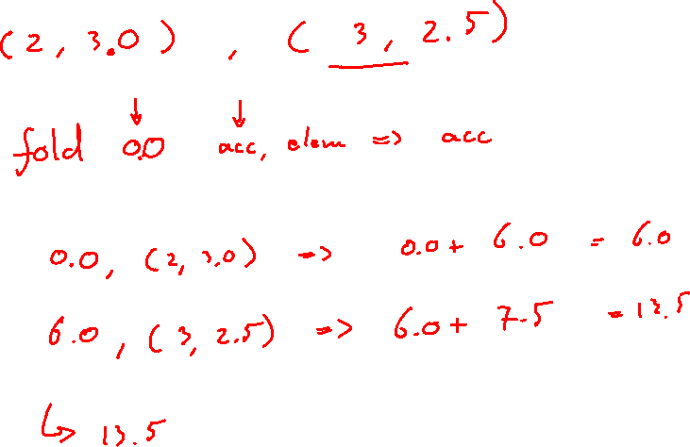
Recursion Lecture 3

Slide 2
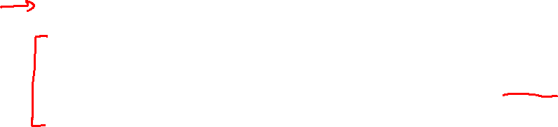
Goals
Goal 1: Reminder of what recursion is
Goal 2: Understand how recursion helps to write clear compact code
Goal 3: Understand how recursion makes it easier to use immutable data structures
Goal 4: Write clear compact code using recursion
Why these goals: Recursion is essential to program in a pure functional style with immutable data structures. Recursion can also make code a lot shorter and more clear.
Notes:
De vraag die we beantwoorden in de introductie.

Slide 3

Recursion
A recursive function is a function that calls itself
def teachersNeededFor(numberOfStudents: Int): Int = { if (numberOfStudents <= 30) 1 else 1 + teachersNeededFor(numberOfStudents - 30) } teachersNeededFor(20) // 1 teachersNeededFor(45) // 2 teachersNeededFor(163) //6

Slide 4
Base case
The base case, also called stop condition or stop criterion, is the case for which the function returns a value without any subsequent recursive calls
def teachersNeededFor(numberOfStudents: Int): Int = { if (numberOfStudents <= 30) 1 else 1 + teachersNeededFor(numberOfStudents - 30) } teachersNeededFor(20) // 1 teachersNeededFor(45) // 2 teachersNeededFor(163) //6

Slide 5
Base case
Every recursive function has and needs a base case
Tip: Before starting to write a recursive function, ask yourself: What is the base case?
def teachersNeededFor(numberOfStudents: Int): Int = { if (numberOfStudents <= 30) 1 else 1 + teachersNeededFor(numberOfStudents - 30) } teachersNeededFor(20) // 1 teachersNeededFor(45) // 2 teachersNeededFor(163) //6

Slide 6
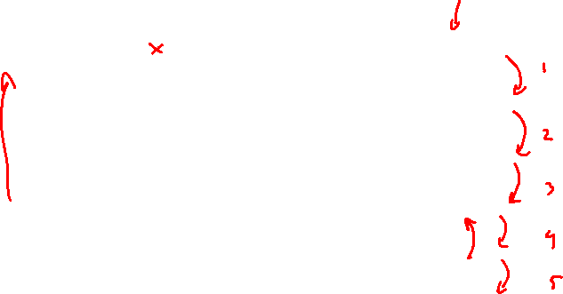
StackOverflow
Each level of recursion adds a call on the stack
But the stack only has a limited amount of memory (around 1 MB by default)
teachersNeededFor(20)
Calls
teachersNeededFor(50)
Calls
teachersNeededFor(80)
Calls
teachersNeededFor(110)
Calls
teachersNeededFor(140)

Slide 7

StackOverflow
Each level of recursion adds call on the stack
But the stack only has a limited amount of memory (around 1 MB by default)
def teachersNeededFor(numberOfStudents: Int): Int = { if (numberOfStudents <= 30) 1 else 1 + teachersNeededFor(numberOfStudents - 30) }
teachersNeededFor(1000000) // StackoverflowError

Slide 8
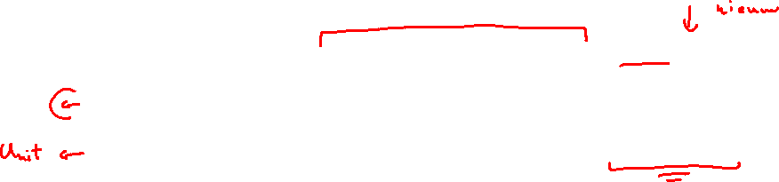
Tail recursion
Tail recursion is recursion where the recursive function call is the last action
Tail recursion allows the compiler to run the recursive function just as efficiently as a loop
def teachersNeededFor(numberOfStudents: Int, result:BigInt = 0): BigInt = { if (numberOfStudents <= 30) result + 1 else teachersNeededFor(numberOfStudents - 30, result + 1) } teachersNeededFor(20) // 1 teachersNeededFor(45) // 2 teachersNeededFor(1000000) // 33334
Notes:
BigInt because because the result of the factorial of 100000 is bigger than the maximum value of int

Slide 9

Tail recursion
Tail recursion allows compilers to remove previous recursive calls from the stack
Scala has the @tailrec decorator to let the compiler know you intend the function to be tail recursive. If it’s not the compiler will warn you.
def teachersNeededFor(numberOfStudents: Int, result:BigInt = 0): BigInt = { if (numberOfStudents <= 30) result + 1 else teachersNeededFor(numberOfStudents - 30, result + 1) }

Slide 10
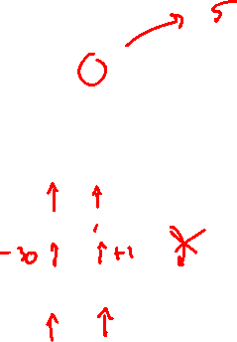
Tail recursion
Tail recursion allows compilers to remove previous recursive calls from the stack
teachersNeededFor(20, 4)
Calls
teachersNeededFor(50, 3)
Calls
teachersNeededFor(80, 2)
Calls
teachersNeededFor(110, 1)
Calls
teachersNeededFor(140, 0)

Slide 11
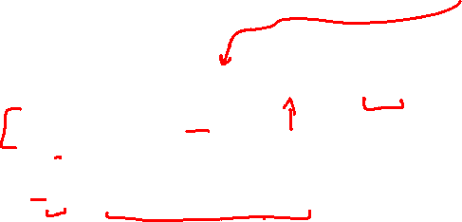
Recursion in immutable collections
Recursion greatly facilitates working with immutable collections
def size(list: List[Int]): Int = { if(list == Nil) 0 else 1 + size(list.tail) } size(List(7,4,2))

Slide 12
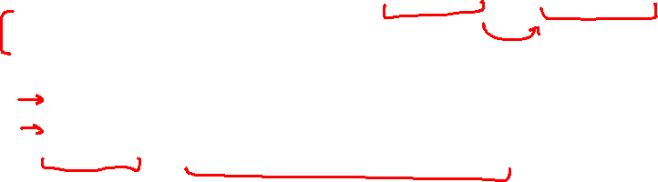
Recursion in immutable collections
Recursion greatly facilitates working with immutable collections
def addTwoToEachElement(list: List[Int]): List[Int] = { if(list == Nil) Nil else{ val head::tail = list val newHead = head + 2 newHead :: addTwoToEachElement(tail) } } addTwoToEachElement(List(7,4,2)) // List(9,6,4)

Slide 13
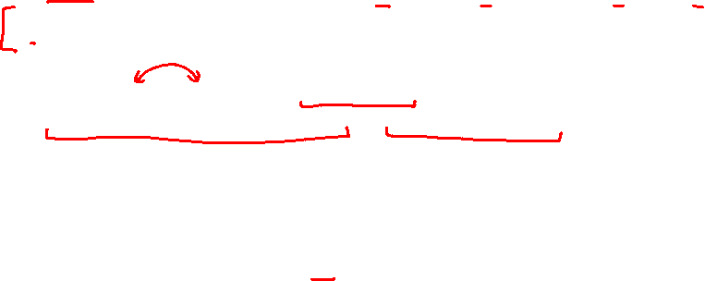
Recursion in immutable collections
Recursion greatly facilitates working with immutable collections
def swapKeyValue(map: Map[String, Int]): Map[Int, String] = { if(map.size == 0) Map() else{ val (key, value) = map.head swapKeyValue(map.tail) + (value -> key) } } val myMap = Map("Bob" -> 27,"Rob" -> 36) swapKeyValue(myMap) // Map(36 -> Rob, 27 -> Bob)

Slide 14
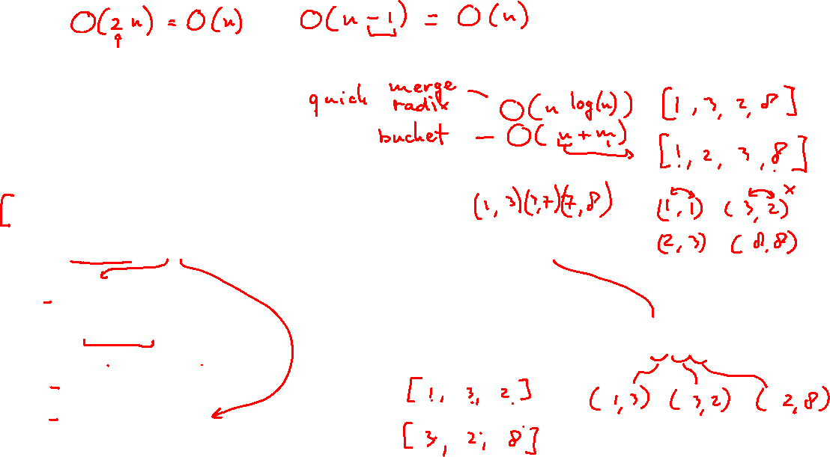
Recursion in immutable collections
Recursion greatly facilitates working with immutable collections
def isAscending(list: List[Int]): Boolean = { if(list == Nil) true else { val element1::tail = list if(tail == Nil) true else { val element2 = tail.head if(element1 >= element2) false else isAscending(tail) } } }
isAscending(List(1,3,7,8)) // true isAscending(List(1,3,2,8)) // false

Slide 15
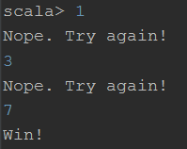
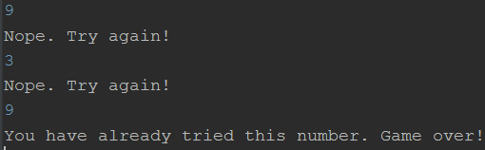
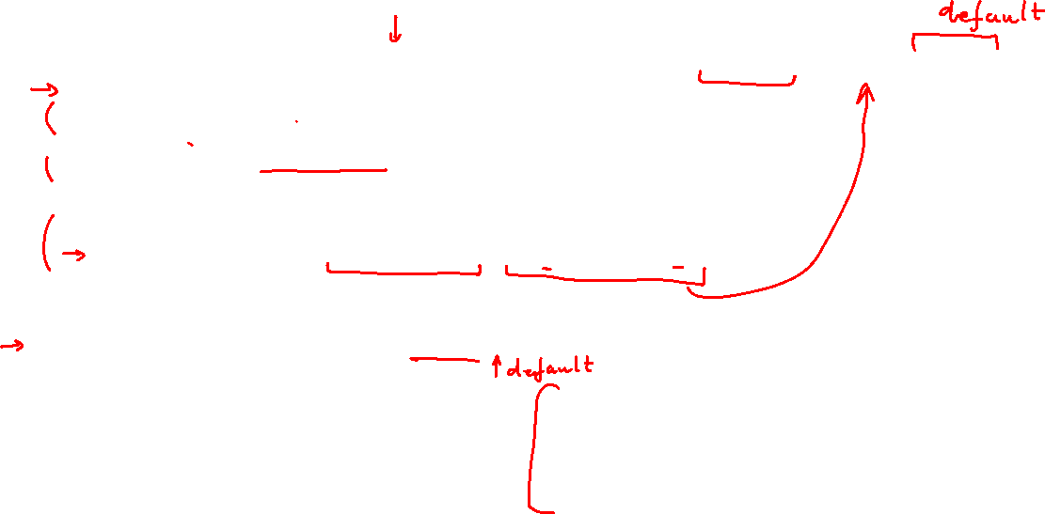
Recursion in immutable collections
def luckyNumberGameLoop(isRightNumber: Int => Boolean, attempts:Set[Int] = Set()) { val input = scala.io.StdIn.readInt() if(isRightNumber(input)) println("Win!") else if (attempts.contains(input)) println("You have already tried this number. Game over!") else{ println("Nope. Try again!") luckyNumberGameLoop(isRightNumber, attempts + input) } } luckyNumberGameLoop((x: Int)=> x == 7)

Slide 16

Achieved goals
Goal 1: Reminder of what recursion is
Goal 2: Understand how recursion helps to write clear compact code
Goal 3: Understand how recursion makes it easier to use immutable data structures
Goal 4: Write clear compact code using recursion
Why these goals: Recursion is essential to program in a pure functional style with immutable data structures. Recursion can also make code a lot shorter and more clear.
Notes:
De vraag die we beantwoorden in de introductie.

